Slide 1
Biofuels and Transportation Decarbonization Under the CLCPA
Tristan R. Brown
Associate Professor of Energy Resource Economics
Department of Sustainable Resources Management
SUNY ESF
Presented at the Empire State Forest Products Association Regional Meeting
September 27, 2021

Slide 2
The CLCPA and transportation
The Climate Leadership and Community Protection Act (CLCPA) requires NYS to achieve the deep decarbonization of its economy by 2050
100% decarbonization of power sector by 2040 on an absolute basis
85% decarbonization by economy on an absolute basis
15% decarbonization by economy via offsets (optional)
Unlike past state policies, the CLCPA requires the deep decarbonization of the NYS transportation sector on an absolute basis

Slide 3
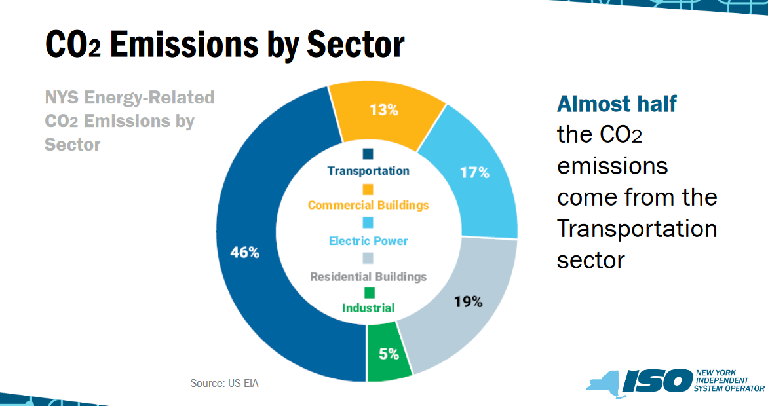
A sizeable fraction of building emissions are also from a refined fuel, distillate heating oil (which is very similar to ULSD)

Slide 4
The limitations of vehicle electrification
2020s vehicle technologies will largely limit electrification to gasoline vehicles
Only 43% of every barrel of petroleum produces gasoline
Only 67% of NYS’s transportation sector GHG emissions come from gasoline vehicles
Diesel fuel, residual fuel, and jet fuel are unlikely to be replaced by electricity before the 2040s (if not later)
The CLCPA’s targets will only be met if the transportation sector is decarbonized via other means
https://www.energy.gov/articles/hows-and-whys-replacing-whole-barrel

Slide 5
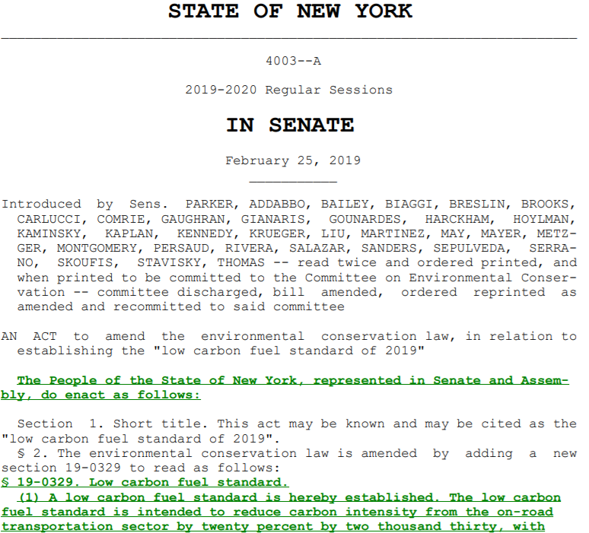
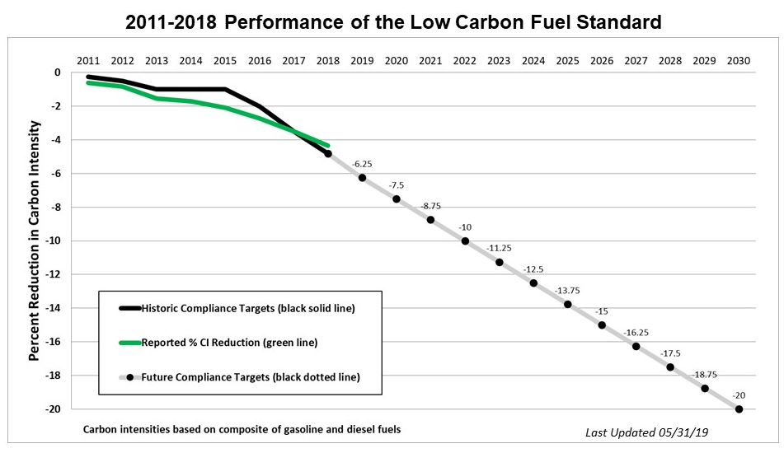
Low Carbon Fuel Standards

Slide 6
Decarbonizing California’s transportation sector
Biomass-based diesel generates almost 50% of all carbon credits
Source: CARB (2020)

Slide 7
How California’s low-carbon fuels contribute
Source: CARB (2020)

Slide 8
California’s driver – carbon credit prices

Slide 9
California’s driver – biofuel subsidy values
Source: CARB (2020)

Slide 10
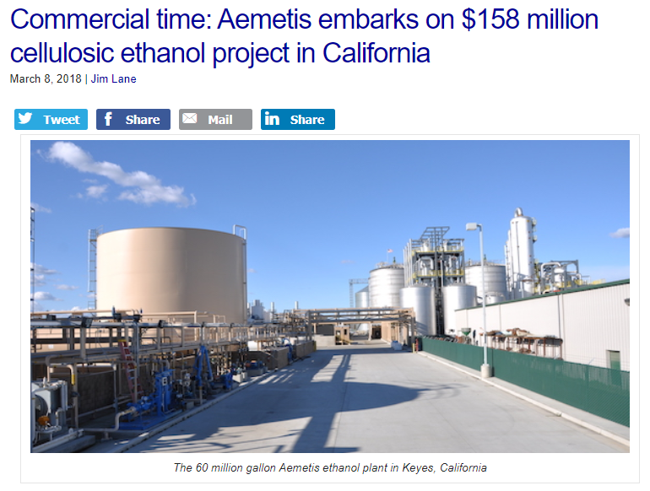
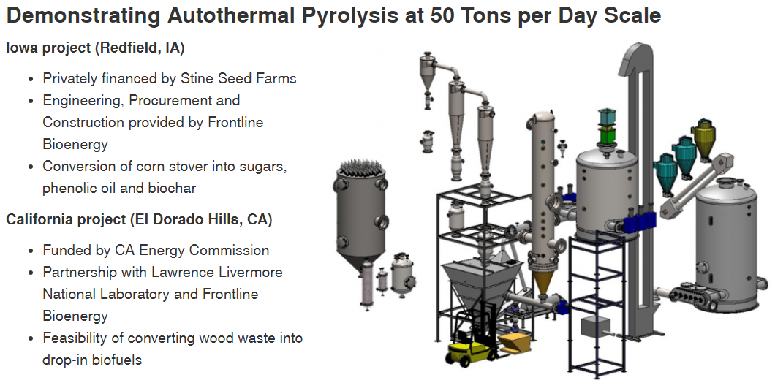
The effect

Slide 11
Conclusions
The CLCPA requires the rapid and thorough decarbonization of NYS’s transportation sector
NYS is currently far behind other states on transportation decarbonization progress
Much of this decarbonization will require the use of biomass to mitigate emissions from “hard-to-electrify” sources such as diesel fuel and jet fuel
California’s LCFS has driven commercialization of 2nd-generation low carbon technologies, including biofuels from forest biomass
Forest biomass will need to play an important role if NYS is to achieve the CLCPA’s decarbonization targets

Slide 12
Questions? trbro100@esf.edu

